Slide 1

Maisammaguda, Kompally, Medchal - Malkajgiri District Hyderabad - 500100, Telangana State. www.mallareddyuniversity.
(Telangana State Private Universities Act No. 13 of 2020 & G.O.Ms. No. 14, Higher Education (UE) Department)
Department of Computer Science & Engineering
Mammary Carcinoma
Batch no. 39
2211CS010363 (M. Bhargav)
2211CS010459 (P. Charan Sai)
2211CS010407 (N. Uday Kumar)
2211CS010514 (S. Harsha Vardhan)
Guide
Mr. G. Raju

Slide 2
Table of Contents
Introduction
Literature Survey
Limitations of Existing Algorithms/Methodologies
Abstract
Proposed Methodology
Hardware/Software Requirements
Conclusion
References

Slide 3
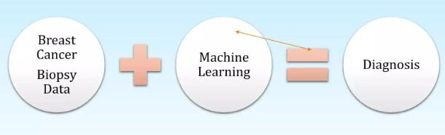
INTRODUCTION
This project focuses on analyzing breast cancer datasets to identify key patterns, correlations, and trends. By leveraging data analytics techniques such as statistical analysis, visualization, and predictive modeling, we aim to extract meaningful insights from patient records, biopsy results, and tumor characteristics.

Slide 4
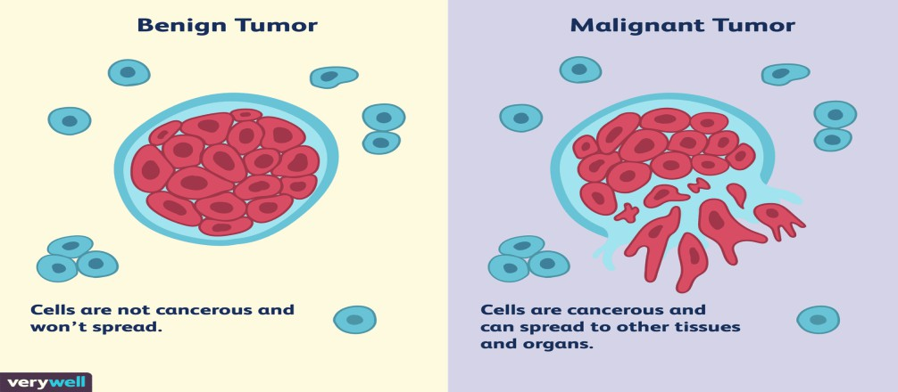
LITERATURE SURVEY
Breast cancer is one of the most prevalent cancers among women worldwide. It occurs due to the uncontrolled growth of cells in breast tissue and can be classified as benign (non-cancerous) or
malignant (cancerous).The number of new breast cancer patients is expected to increase by 70% in the next 20 years. Therefore, early and accurate diagnosis plays a pivotal role in improving prognosis and increasing the survival rate of cancer patients from 30 to 50%

Slide 5
LIMITATIONS OF EXISTING ALGORITHMS
Incomplete or Missing Data: Patient records may have missing values for important attributes like tumor size, hormone receptor status, etc.
Poor User Interface: Doctors and healthcare professionals may find existing systems difficult to use.
Slow Data Processing: Existing systems may not process large datasets efficiently,
causing delays in diagnosis.
Overfitting: AI/ML models may perform well on training data but fail in real-world clinical
applications.

Slide 6
ABSTRACT
Breast cancer is one of the most common forms of cancer among women, and early detection plays a critical role in improving survival rates. This project focuses on leveraging data analytics to enhance understanding, diagnosis, and treatment of breast cancer. Utilizing a dataset comprising patient demographic information, diagnostic features, and medical outcomes, we apply machine learning techniques and statistical analyses to identify patterns and key indicators associated with breast cancer.
The project involves preprocessing and cleaning the dataset, feature selection to identify significant variables, and building predictive models to classify malignant and benign cases with high accuracy. Advanced visualization techniques are used to explore the relationships between clinical features such as tumor size, texture, and shape.

Slide 7
PROPOSED METHODOLOGY
Problem Definition
Data Collection
Data Preprocessing & Cleaning
Exploratory Data Analysis (EDA)
Model Development
Deployment & Interpretation
Conclusion & Future Work

Slide 8
HARDWARE REQUIREMENTS
Processor (CPU): Intel Core i3/i5 or AMD Ryzen 3/5 (Quad-core or higher)
RAM: 8GB – 16GB
Storage: 256GB – 512GB SSD (HDD not recommended)
GPU: Not required for basic statistical analysis or small ML models
OS: Windows 10/11, macOS
Internet: Required for cloud-based analytics (Google Colab)

Slide 9
SOFTWARE REQUIREMENTS
Operating System: Windows 10/11,
Programming Languages: Python
Development Environment: Jupyter Notebook, VS Code
Libraries & Frameworks:
Data Handling & Processing: Pandas, NumPy
Data Visualization: Matplotlib, Seaborn
Machine Learning & Model Building: Scikit-learn (Logistic Regression, SVM, Decision Tree, Random Forest)
Data Preprocessing & Feature Selection: Scikit-learn
Deployment: Streamlit

Slide 10
CONCLUSION
Breast cancer data analytics plays a crucial role in early detection, diagnosis, and treatment planning. By leveraging data-driven insights, healthcare professionals can improve patient outcomes through accurate risk assessment, predictive modeling, and personalized treatment strategies.
This project has demonstrated the power of machine learning and statistical analysis in identifying key patterns and risk factors associated with breast cancer. The findings highlight the importance of early screening, feature selection, and model optimization to enhance predictive accuracy.

Slide 11
REFERENCES
Datasets
Wisconsin Breast Cancer Dataset (WBCD)
https://archive.ics.uci.edu/dataset/17/breast+cancer+wisconsin+diagnostic
Breast Cancer Histopathological Image Dataset
https://www.kaggle.com/datasets/paultimothymooney/breast-histopathology-images
Research Papers & Studies
Breast Cancer Prediction Using Fine Needle Aspration
https://pmc.ncbi.nlm.nih.gov/articles/PMC9913345/
Explainable AI in Breast Cancer Diagnosis
https://pmc.ncbi.nlm.nih.gov/articles/PMC10840064/#:~:text=Recently%2C%20explainable%20artificial%20intelligence%20(XAI,and%20ultrasound
%20(US)%20images.

Slide 12
THANK YOU

